Slide 1
LOG ANALYIS USING SPARK

Slide 2
Project Statement
Utilize Azure Data Factory to ingest data into Azure Storage, and leverage Azure Databricks for log analysis using Apache spark for insights such as error rates, trends and anomalies.

Slide 3
Project overview:
The project integrates Azure Data Factory for log data ingestion into Azure Storage and Azure Databricks with Apache Spark for log analysis.
It begins with setting up Azure Data Factory to extract log data and orchestrate its movement into Azure Storage. Azure Databricks is then configured to access this data, employing Spark for robust log analysis.
Using Spark's distributed computing capabilities, the project conducts various analyses including error rate calculation, trend identification, and anomaly detection within the log data.
Leveraging Azure's scalability and reliability, the project offers organizations actionable insights, aiding in system enhancement and informed decision-making based on log data patterns.

Slide 4
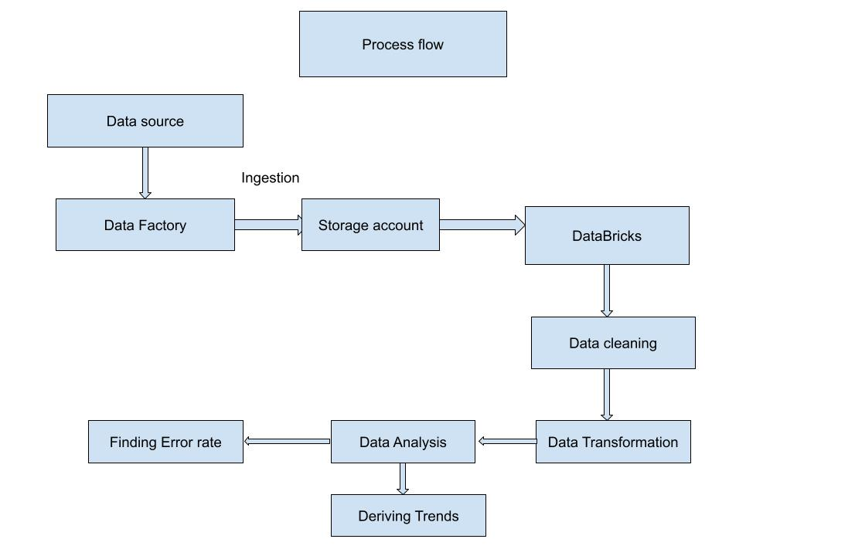
Process flow

Slide 5
Azure Resources used:
Azure Storage accounts
Azure Data Factory
Azure Databricks

Slide 6
Project Requirements:
Generate log data
Create a pipeline for copy activity
Ingestion of generated log data
Create a databricks cluster
Write code for data analysis

Slide 7
Implementation:
Firstly, the log data has been generated from a python code.
Now this data is ingested into azure blob storage by perform a copy activity using azure data factory.
For this we need to create a pipeline in data factory.
Configure all the settings required for copy activity.
Now trigger the pipeline
Then the data is successfully gets copied

Slide 8
Now create an azure databricks workspace
After that create a cluster in databricks workspace
Create a new notebook
Write code to create a connection between azure blob storage and databricks
Load the data into dataframe
Perform data cleaning and transformation techniques
Find error rates
Derive trends from the data

Slide 9
Technologies used
Azure Storage account
Azure data factory
Azure databricks
Apache Spark
Python
Spark SQL
Visualization

Slide 10
Thank You

